Slide 1
API Design
ti&m academy
Zürich, 19. Juni 2017
Ursin Brunner, Daniel Regli, David Bach

Slide 2
HTTP

Slide 3
ti&m academy – Content
Intro
Resources & Relations
HTTP Verbs & Status Codes
PUT vs. POST
Partial Update
Path & Query Parameter
Advanced Topics
Pagination
Versioning (Optional)
HATEOAS (Optional)
Appendix, Links

Slide 4
Look at the current huge tech companies: Facebook, Twitter, Google, GitHub, Amazon, Netflix… None of them would be nearly as big as they are today if they hadn’t opened up their data via API. In fact, an entire industry exists with the sole purpose of consuming data provided by said platforms.
https://codeplanet.io/principles-good-restful-api-design/

Slide 5
Intro – Developer Experience (DX)
An API is a developer's UI - just like any UI, it's important to ensure the user's experience is thought out carefully!
Use web standards where they make sense
It should be friendly to the developer and be explorable via a browser address bar
It should be simple, intuitive and consistent to make adoption not only easy but pleasant
Provide examples and documentation
Invest not only for «public» APIs in the DX
(Internal users are important too!)

Slide 6
Intro– SOAP vs. REST
SOAP
SOAP is a protocol
Language, platform, and transport independent (REST requires use of HTTP)
Works well in distributed enterprise environments
Standardized
Provides significant pre-build extensibility in the form of the WS* standards
Example SOAP services
searchCusomer
updateCustomerAndAddNewCar
addCustomer
getCustomerById
REST
REST is a architecture style
No expensive tools require to interact with the Web service
Smaller learning curve
Efficient (SOAP uses XML for all messages, REST can use smaller message formats such as JSON)
Fast (no extensive processing required)
Closer to other Web technologies in design philosophy
Example REST resources
GET /customers
PUT /customers/{id} ; POST /cars
POST /customers
/customers/{id}

Slide 7
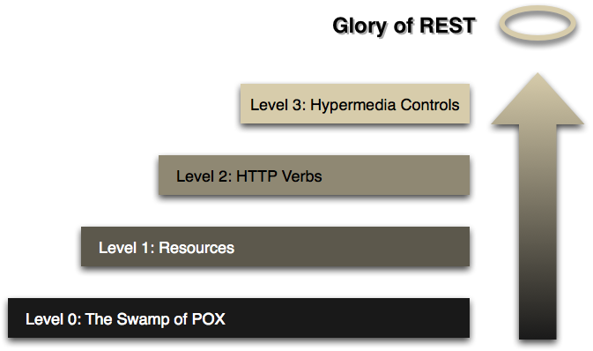
Intro – Levels (Richardson Maturity Model)
Level 3 = HATEOAS
More information: http://martinfowler.com/articles/richardsonMaturityModel.html

Slide 8
Intro – Swagger 2.0 / OpenAPI
History
2010 Start development of the spec (Wordnik Developer)
2015 bought by SmartBear (SoapUI)
2015: donated to the Linux Foundation
Microsoft, Google und IBM are founding members
New name of the foundation: OpenAPI Initiative
New name of the specification: OAS = OpenAPI Specification
Technology / Features
JSON/YAML for the spec
Nice web editor: http://editor.swagger.io
Language independent
Many 3rd party tools (mock servers, code generators, documentation generators, ...)
Alternatives
RAML, API Blueprint, WADL, Odata, Slate
Live Demo

Slide 9
Resources & Relations – Introduction
Resources
Resources are the key element in API design
Resources should be nouns (and not verbs)
The resource centerd design is one of the main difference between REST-styled APIs and RPC/SOAP-styled APIs
Use plural (tickets and not ticket)
REST style:
/tickets (all tickets)
/tickets/312 (a specific ticket)
RPC/SOAP style:
getAllTickets, getTicketById
Relations
If a resource is related to another resource use subresources:
/tickets/312/messages -> all messages from ticket 312
/tickets/312/messages/3 -> message 3 from ticket 312

Slide 10
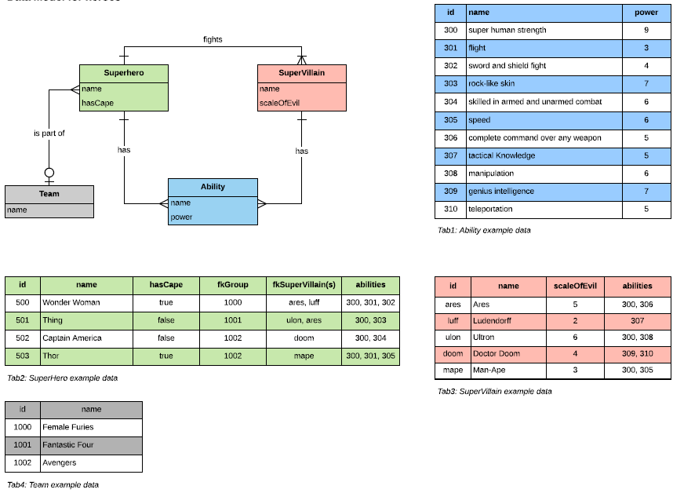
Examples – Data Model

Slide 11
Resources & Relations: Exercise 1

Slide 12
HTTP Verbs & Status Codes – Introduction
GET (SELECT, READ): Retrieve a specific Resource from the Server, or a listing of Resources.
POST (CREATE): Create a new Resource on the Server.
PUT (UPDATE, CREATE): Update or create a Resource on the Server, providing the entire Resource.
PATCH (UPDATE): Update a Resource on the Server, providing only changed attributes.
DELETE (DELETE): Remove a Resource from the Server.
Here are two lesser known HTTP verbs:
HEAD – Retrieve meta data about a Resource, such as a hash of the data or when it was last updated.
OPTIONS – Retrieve information about what the Consumer is allowed to do with the Resource.

Slide 13
HTTP Verbs & Status Codes – Introduction
200 OK – (GET): The Consumer requested data from the Server, and the Server found it for them (Idempotent)
201 CREATED – (POST/PUT/PATCH): The Consumer gave the Server data, and the Server created a resource
204 NO CONTENT – (DELETE): The Consumer asked the Server to delete a Resource, and the Server deleted it
400 INVALID REQUEST – (POST/PUT/PATCH): The Consumer gave bad data to the Server, and the Server did nothing with it (Idempotent)
404 NOT FOUND – (*): The Consumer referenced an inexistant Resource or Collection, and the Server did nothing (Idempotent)
500 INTERNAL SERVER ERROR – (*): The Server encountered an error, and the Consumer has no knowledge if the request was successful
Full List of status codes: https://en.wikipedia.org/wiki/List_of_HTTP_status_codes

Slide 14
HTTP Verbs & Status Codes – PUT vs. POST
Both PUT and POST can be used for creating.
You do not need to support both PUT and POST.
Which is used is left up to you. But just remember to use the right one depending on what object you are referencing in the request.
Some considerations:
Do you name(id) your URL objects you create explicitly, or let the server decide? If you name them then use PUT. If you let the server decide then use POST.
PUT is idempotent, so if you PUT an object twice, it has no effect.
You can update or create a resource with PUT with the same object URL
With POST you can have 2 requests coming in at the same time making modifications to a URL, and they may update different parts of the object.

Slide 15
HTTP Verbs & Status Codes – PUT Example for create
Offline API
When you have an API which is offline usable it makes sense to use PUT for create a new resource:
PUT /tickets/UUID
You are now able to use the new created resource within your application (e.g. mobile app)
When going back online with the application, it can now sync the local created resources back to the backend without having conflicts concerning the id of the resource

Slide 16
HTTP Verbs & Status Codes: Exercise 2,3,4,5,6

Slide 17
HTTP Verbs & Status Codes – Path & Query Parameters
Filtering:
Use a unique query parameter for each field that implements filtering.
For example, you may want to limit these to only those in the open state. This could be accomplished with a request like:
GET /tickets?state=open.
Sorting:
A generic parameter sort can be used to describe sorting rules.
Accommodate complex sorting requirements by letting the sort parameter take in list of comma separated fields
GET /tickets?sort=-priority,created_at
Searching:
A full text search can be exposed on the API as a query parameter on the resource's endpoint.
GET /tickets?q=ti8m

Slide 18
Path & Query Parameters : Exercise 7

Slide 19
Advanced Topic– Pagination
1. Envelope
GET /tickets
{ "offset": 0,
"limit": 10,
"total": 4121,
“tickets": [ //... ] }
GET /tickets?offset=30&limit=15 #returns the employees 30 to 45
2. Link Header
With RFC 5988 we can also use the a Link header to return a set of ready-made links so the API consumer doesn't have to construct links themselves.
Example (from github): Link: <https://api.github.com/user/repos?page=3&per_page=100>; rel="next", <https://api.github.com/user/repos?page=50&per_page=100>; rel="last"
An API that requires sending a count can use a custom HTTP header like X-Total-Count.

Slide 20
Advanced Topic Pagination: Exercise 8

Slide 21
Advanced Topic – Versioning
When making backwards-incompatible changes to an API, it makes sense to release a new version of the API
The version can be provided by
URL: /v1.2/tickets
or within the Header: curl http://localhost:8080/api/tickets -H «API-Version: v1.2»
It is very controversial which approach is better…
A combination of both approaches is also possible (e.g. Stripe API).
Major version in the URL
Minor version in the Header
Requests without mentioning a version should redirect to the current stable API version

Slide 22
Advanced Topic Versioning: Exercise 9

Slide 23
Advanced Topic – HATEOAS
HATEOAS (Hypermedia as the Engine of Application State) is a constraint of the REST application architecture.
A hypermedia-driven site provides information to navigate the site's REST interfaces dynamically by including hypermedia links with the responses
A normal website generally works on HATEOAS type principles (where we go to a website's front page and follow links based on what we see on the page)

Slide 24
Advanced Topic – HATEOAS Example
GET /accounts/12345
<?xml version="1.0"?>
<account>
<account_number>12345</account_number>
<balance currency="usd">100.00</balance>
<link rel="deposit" href="https://bank.example.com/accounts/12345/deposit" />
<link rel="withdraw" href="https://bank.example.com/accounts/12345/withdraw" />
<link rel="transfer" href="https://bank.example.com/accounts/12345/transfer" />
<link rel="close" href="https://bank.example.com/accounts/12345/close" />
</account>
GET /accounts/12345
<?xml version="1.0"?>
<account>
<account_number>12345</account_number>
<balance currency="usd">-25.00</balance>
<link rel="deposit" href="https://bank.example.com/account/12345/deposit" />
</account>

Slide 25
Advanced Topic HATEOS: Exercise 10

Slide 26
ti&m – Vielen Dank
Wir digitalisieren Ihr Unternehmen.
ti&m academy
academy@ti8m.ch
ti&m AG
Buckhauserstrasse 24
CH-8048 Zürich
Monbijoustrasse 68
CH-3007 Bern
Telefon +41 44 497 75 00
E-Mail info@ti8m.ch
Twitter @ti8m_ag Facebook ti8m.ch/fb
www.ti8m.ch
Consulting. Design. Agile Projects. Products. Innovation Hosting.

Slide 27
Appendix – Example, Links and Books
Links
HTTP Standard (Status & Methods) https://tools.ietf.org/html/rfc7231
Best Practises: http://www.vinaysahni.com/best-practices-for-a-pragmatic-restful-api
Stackoverflow: http://stackoverflow.com/questions/tagged/api-design
Examples
Google Drive API (Für binäre Daten): https://developers.google.com/drive/v3/reference/files
GitHub API: https://developer.github.com/v3/
Stripe API: https://stripe.com/docs/api
Books (open to sugesstions)
“Build APIs You Won't Hate” von Phil Sturgeon

Slide 28
Appendix – OpenAPI/Swagger universe
Test and Mocking
Prism Mock Server: http://stoplight.io/platform/prism/
Documentation
Editor, Dokumentation: http://editor.swagger.io
ReDoc: https://github.com/Rebilly/ReDoc
Full list of tools:
http://swagger.io/open-source-integrations/

